Slide 1
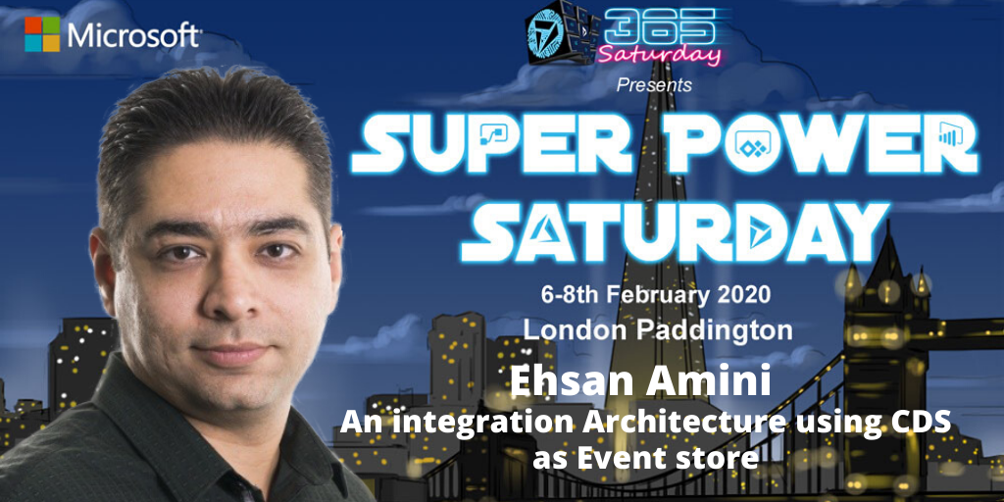

Slide 2
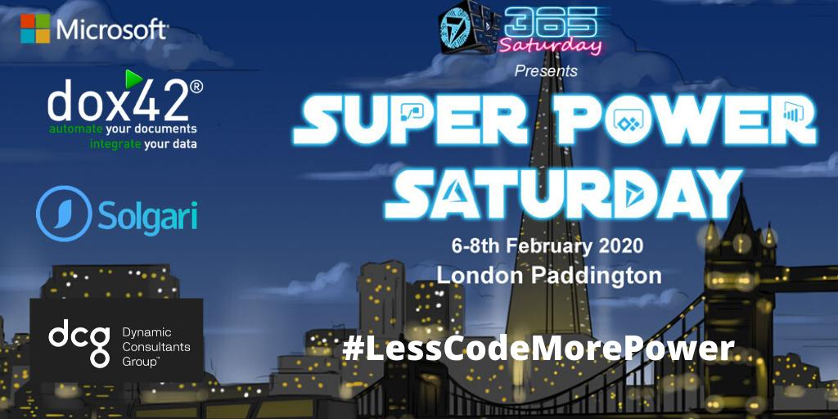

Slide 3


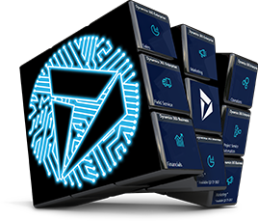



Social
www.365portal.org
Twitter: @Dyn365Community
Linkedin: @365-Saturday
Hashtags
#SuperPowerSaturday #365Saturday #msdyn365 #LessCodeMorePower #PowerAddicts
Community.Dynamics365.com

Slide 4

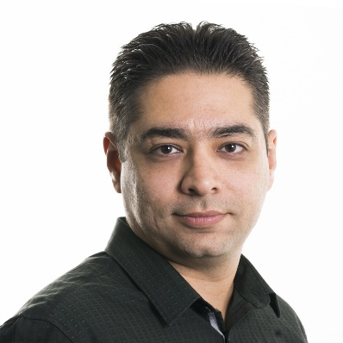


Ehsan Amini Senior Technical Engineer ehsan.amini@outlook.com
https://github.com/EhsanAminii
@ehsannamini

Slide 5
Agenda
Introduction/History
Challenges
Idea
Demo

Slide 6
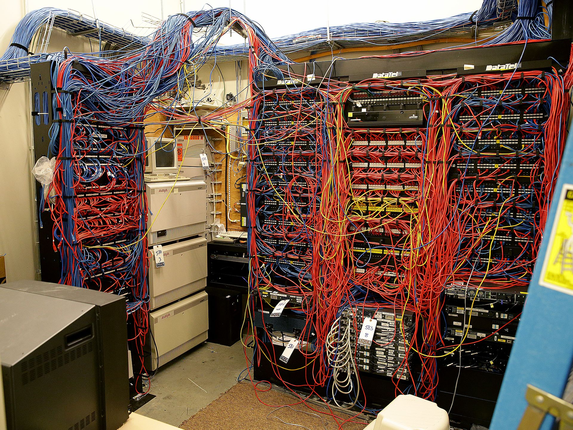
Notes:
Who can remember that or saw that some where before? A server room with lots of cable.

Slide 7
Notes:
do you see some similarities here?

Slide 8

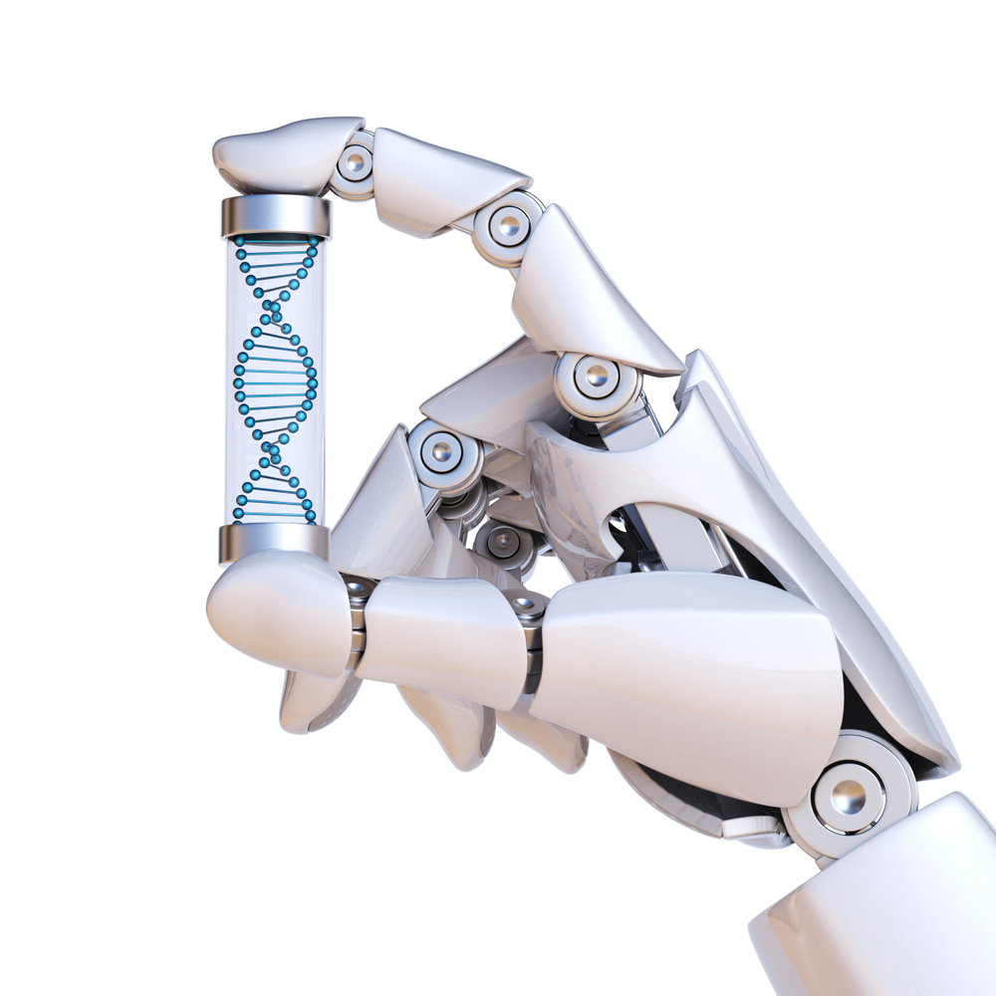
Better Architecture

Slide 9
Publisher/subscriber

Slide 10

Challenges
Common Data model (CDM)
Concurrency issue
source of truth?
Big data
Monitoring

Slide 11

Idea!
Power Platform
Common Data service (CDS)
Building Source of truth
Event sourcing

Slide 12
Architecture overview

Slide 13


Slide 14

Thank you

Slide 15
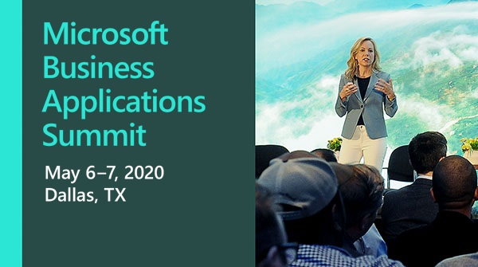

Slide 16


Dynamics 365 Community
Join the Dynamics 365 Community, where you can interact with your peers and Microsoft Dynamics 365 experts. You can get answers to your questions by posting questions in the forums, starting discussions, reading informative blog articles, and watching how-to videos.
https://community.dynamics.com
Benefits
Participate and help build a pool of knowledge that’s accessible by members at any time!
Expand your network by engaging with peers
Involvement
Need help? Ask questions and join in on business or technical discussions in the forums
Share your expertise by hosting a blog or syndicating your existing blog
Recognition
Earn badges for participation and engagement
Become a Community Star and earn appreciation from peers
Join Today!
Get answers, find inspiration, connect with others
Free membership
Any questions? Email us at dlcommed@Microsoft.com

